Slide 1
Practical applications of IIIF As a building block towards a digital National Collection Webinar 2, 11 June 2021
IIIF all the things What goes into providing IIIF for millions of items? Or even a National Collection? Tom Crane looks at large-scale IIIF implementation, with particular focus on Wellcome Collection.
Tom Crane
Technology Director, Digirati cultural-heritage.digirati.com
@tomofhernehill
Notes:
(maximise screen)
I’m Tom Crane, technology director of Digirati. I’m also one of the editors of the IIIF Specifications.
Today I’m going to talk about BIG IIIF.

Slide 2
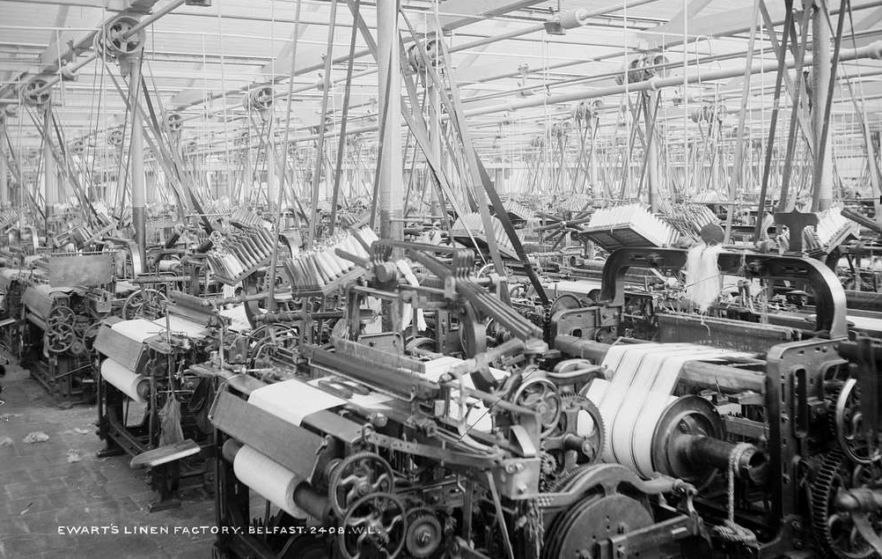
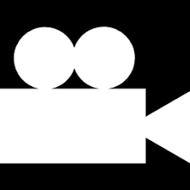
Most Manifests are built by machines
There are 100s of millions of digital objects represented by Manifests.
As most of these are books, there are billions of Canvases.
METS MARC
CIDOC-CRM
DUBLIN CORE
Etc
Etc
Etc
National Library of Ireland Public Domain
Notes:
Most Manifests are built by machines
In the last webinar, I used this slide to illustrate what I wasn’t going to talk about - large scale IIIF production. I then went on to explore ways of making ad hoc, hand crafted manifests.
But in this webinar, we will have a very brief look at industrial IIIF production.
The existence of the IIIF standard means that we can see quite a few convergent solutions in this space.

Slide 3
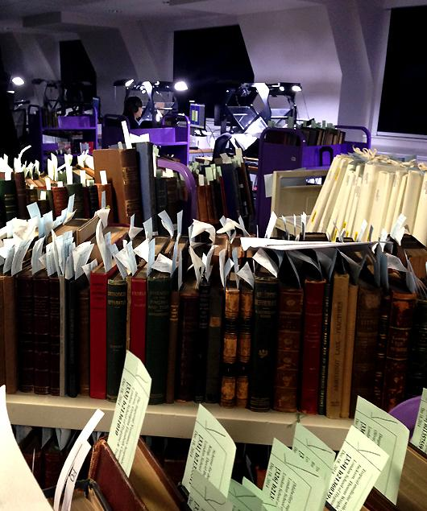
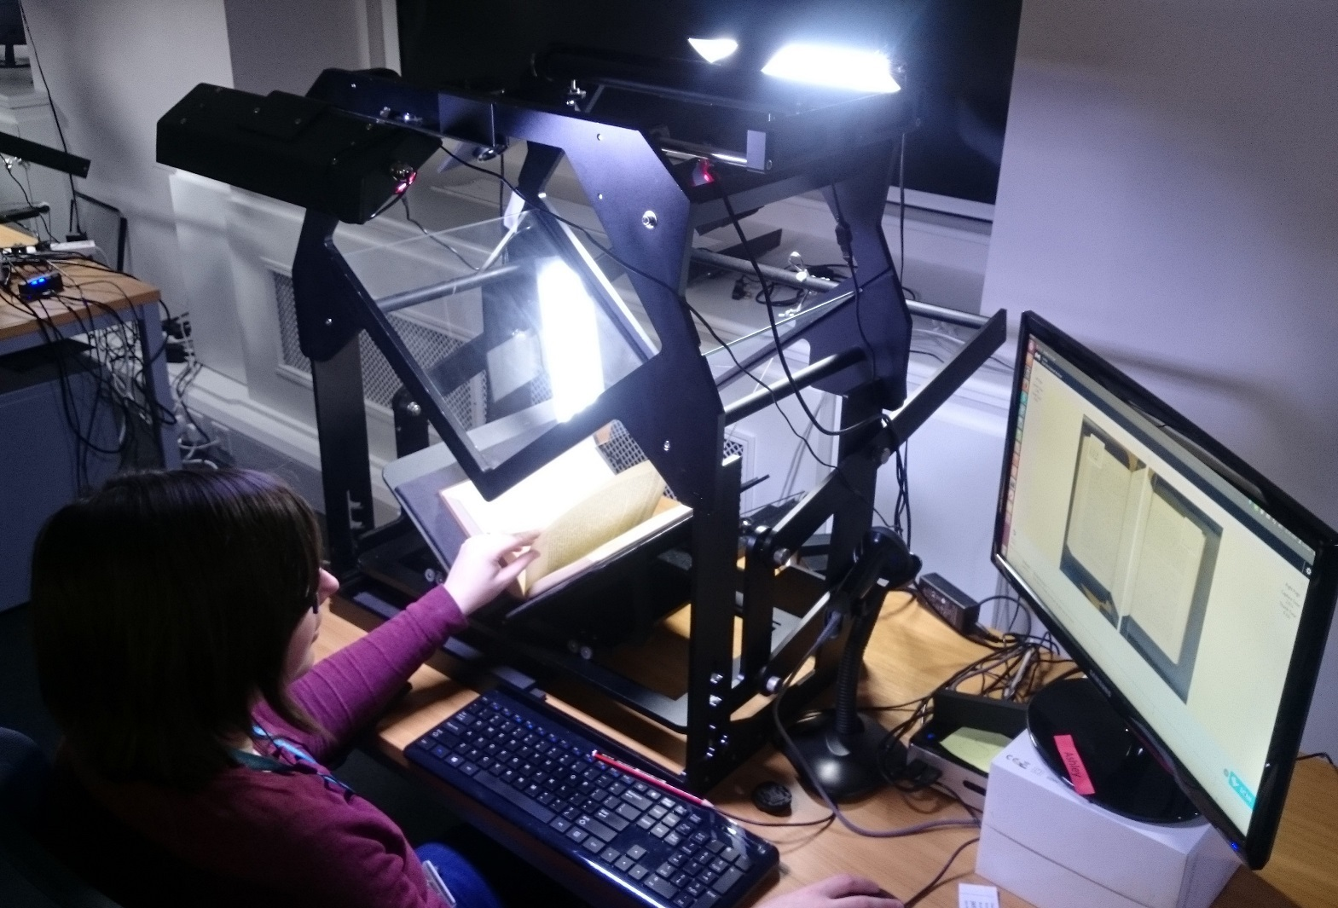
Photos: Christy Henshaw
Notes:
And it is a factory floor… here’s part of Wellcome’s.
At full capacity, over a million digitised pages a month were coming out of here (these pics are pre-pandemic).

Slide 4
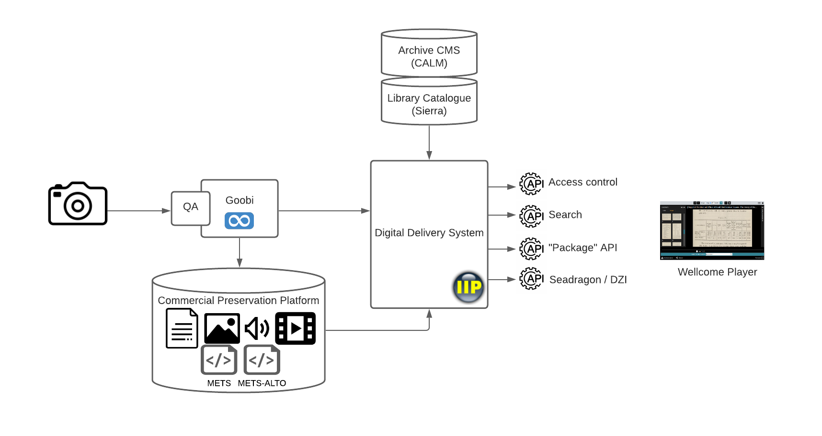
The era before IIIF… c. 2012
Notes:
The era before IIIF… c. 2012
How does this happen? It need lots of humans and lots of software infrastructure.
We’ve been working with Wellcome for nearly 10 years, revisiting this process every so often over that time.
Here’s what the first version looked like 9 years ago, pre-IIIF. I’m looking at this from the Delivery end, the bit we did, rather than the production end, so I’m afraid I’m glossing over the complexity and people involved on the left hand side of this diagram.
Pictures get captured, QA happens, workflow software (Goobi) manages this process, the assets get stored in a Preservation system. METS files describe the digital objects, and METS-ALTO files carry their OCRed text.
Then, the Digital Delivery System turned this information into a bespoke JSON API, mixing in descriptive metadata from library and archive catalogues. The results of all this could be seen in the Wellcome Player.

Slide 5
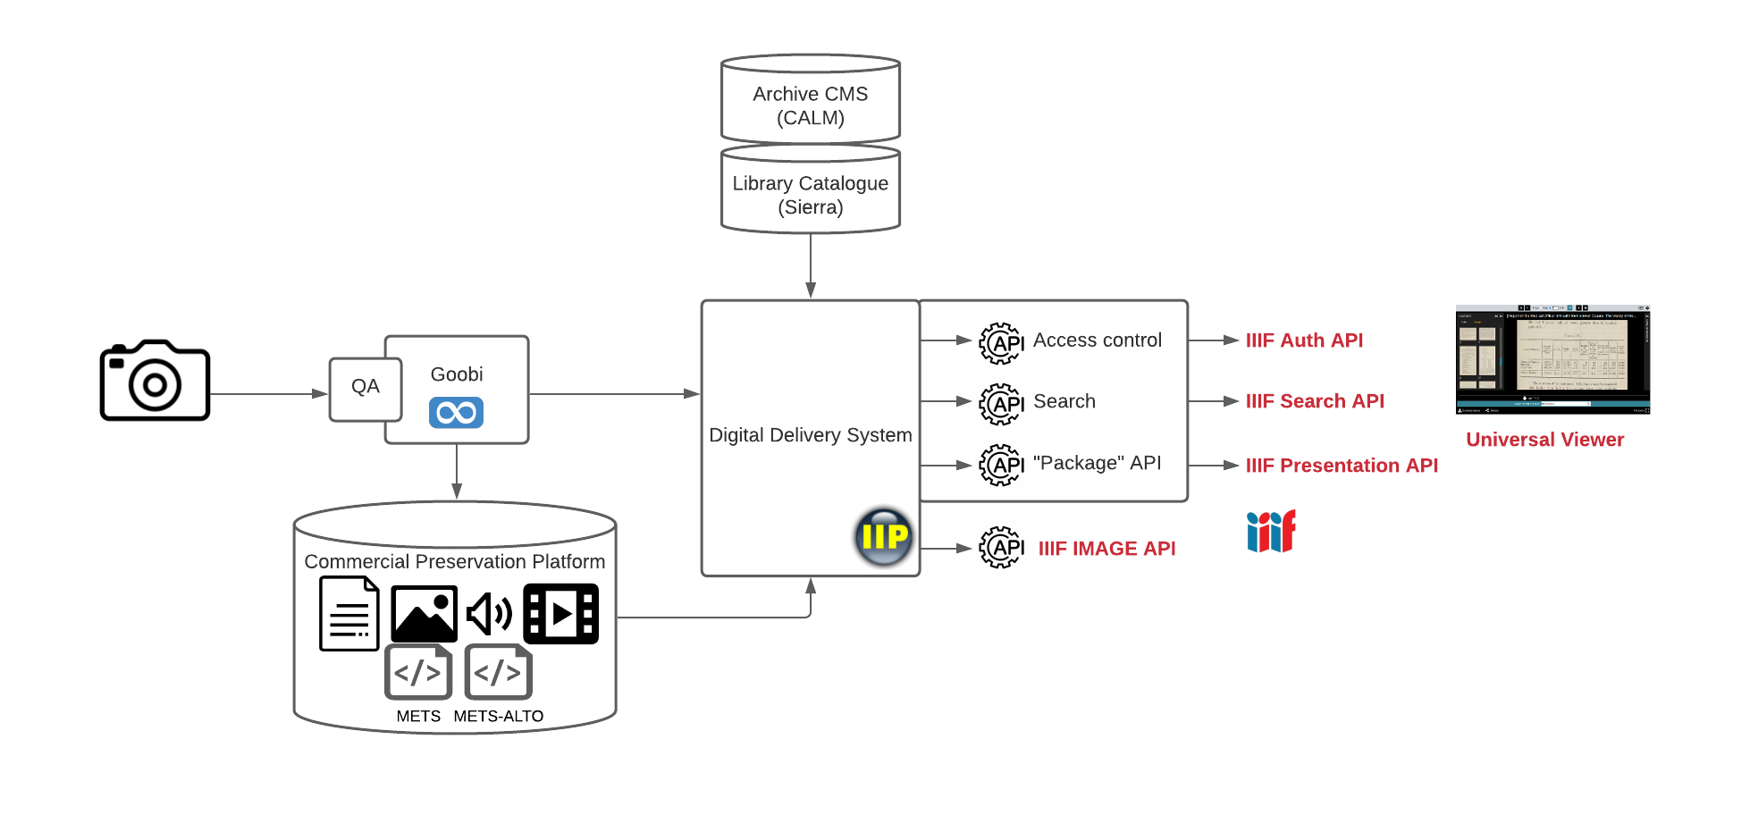
Shiny IIIF Overcoat
Notes:
When IIIF came along, we added a new layer on top of the existing system, that turned it into IIIF - Manifests, but also early versions of the IIIF Search and Auth APIs.
The Wellcome Player became, via the British Library, the Universal Viewer.

Slide 6
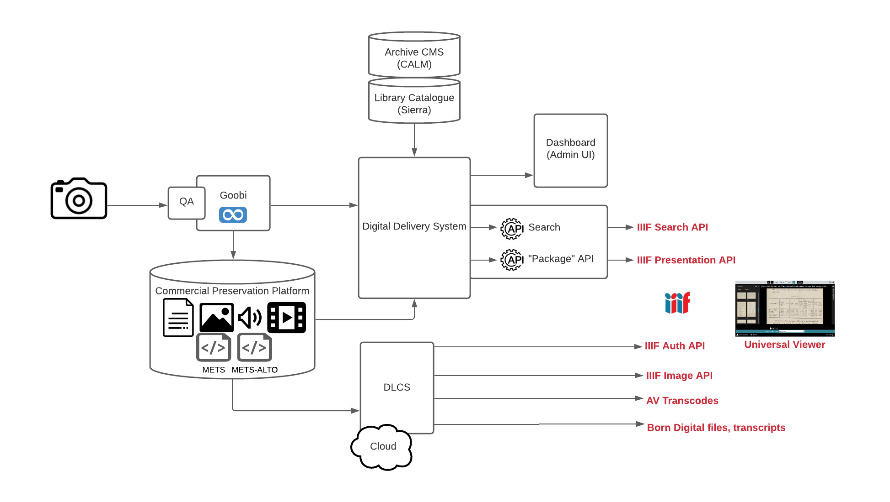
DLCS - Asset Delivery as a commodity service
Notes:
About 30 million images later, we extracted asset delivery into a cloud-based service called DLCS. The existence of the IIIF Specifications allowed us to turn this into a commodity service - it’s driven by shared API specifications, rather than Wellcome-specific things.
(It means Digital Library Cloud Services)

Slide 7
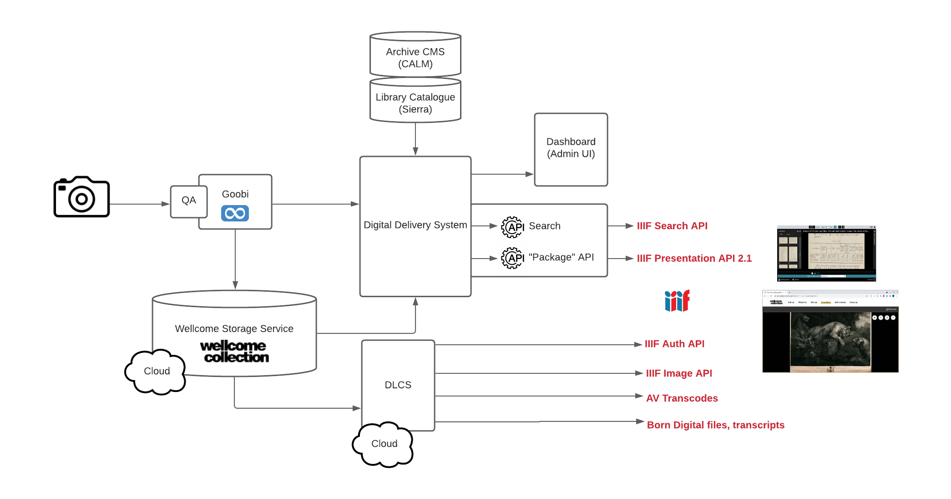
New Storage Service
Notes:
Wellcome replaced their Preservation system with their own, open source implementation, so we adapted the Digital Delivery System to work with that instead.
I’ve added some links to the slides about this.
(read about Wellcome’s storage service here) https://stacks.wellcomecollection.org/building-wellcome-collections-new-archival-storage-service-3f68ff21927e

Slide 8
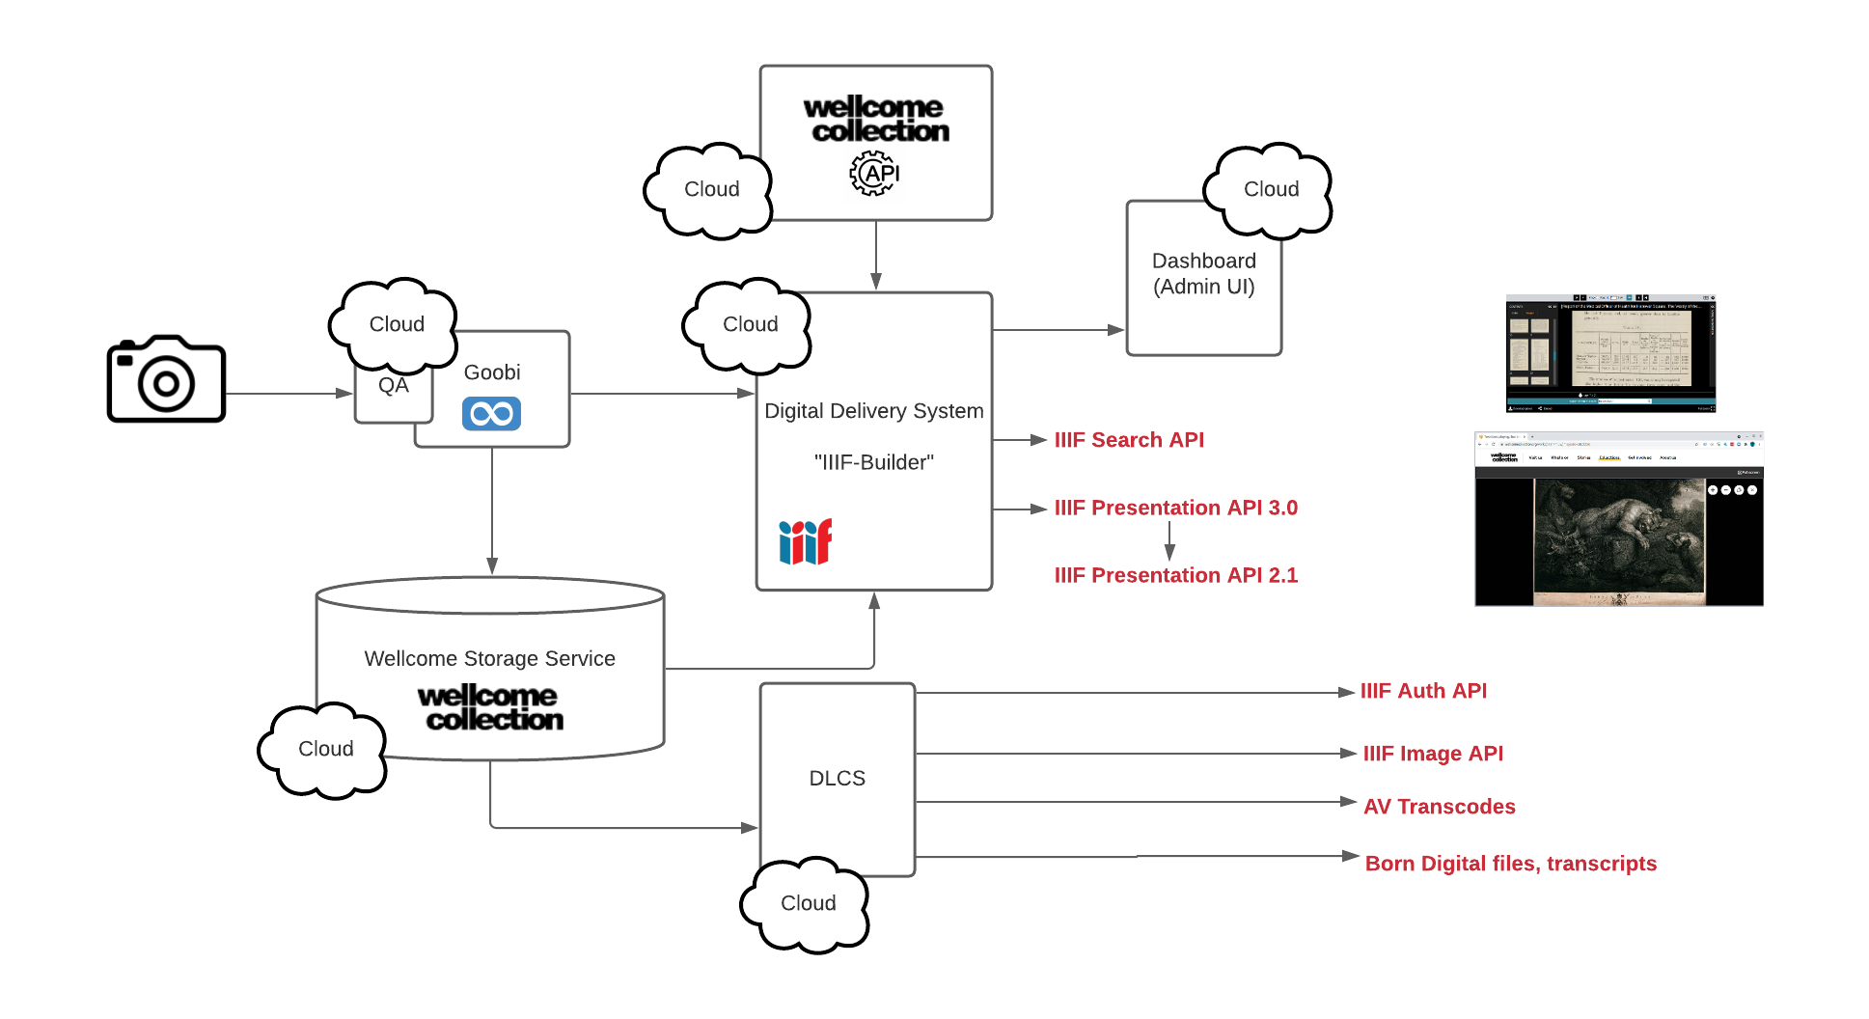
Cloud everything, and IIIF 3
Notes:
And finally, the most recent piece of work was to retire all the on premise infrastructure, adapting everything to run in the cloud - overhaul it for the 2020s.
We removed the archaeological layer of pre-IIIF API. The Delivery System’s internal model is now IIIF 3, not some other unnecessary abstraction layer between the METS and the internet. We still serve IIIF 2, but this is now a derivative of the IIIF 3 - it’s “back-converted”.
We also used Wellcome’s public Catalogue API for all descriptive metadata, removing any dependency on source catalogues.

Slide 9
DLCS - Asset Delivery as a commodity service
Tell me about an image and I will provide a IIIF Image API service for it
Tell me about an AV resource and I will provide web-friendly derivatives for it
I can provide the IIIF Authentication API for all these resources
I can do this for other types of file too, where a derivative is not needed - like PDFs
Notes:
DLCS - Asset Delivery as a commodity service
Returning to asset delivery, briefly. This is what it does:
Tell me about an image and I will provide a IIIF Image API service for it
Tell me about an AV resource and I will provide web-friendly derivatives for it
I can provide the IIIF Authentication API for all these resources
I can do this for other types of file too, where a derivative is not needed - like PDFs
I can generate manifests from sequences of images, but I don’t go further than that into IIIF Presentation.
DLCS is designed for systems integration, but it can be used by humans too:

Slide 10
Separating concerns and enabling other uses
(Demo)
Notes:
Here is some top quality Archive content. A Dixon’s catalogue from 1985.
DLCS organises content into spaces - like folders - and we can turn a space into a IIIF Manifest by flicking a switch.

Slide 11
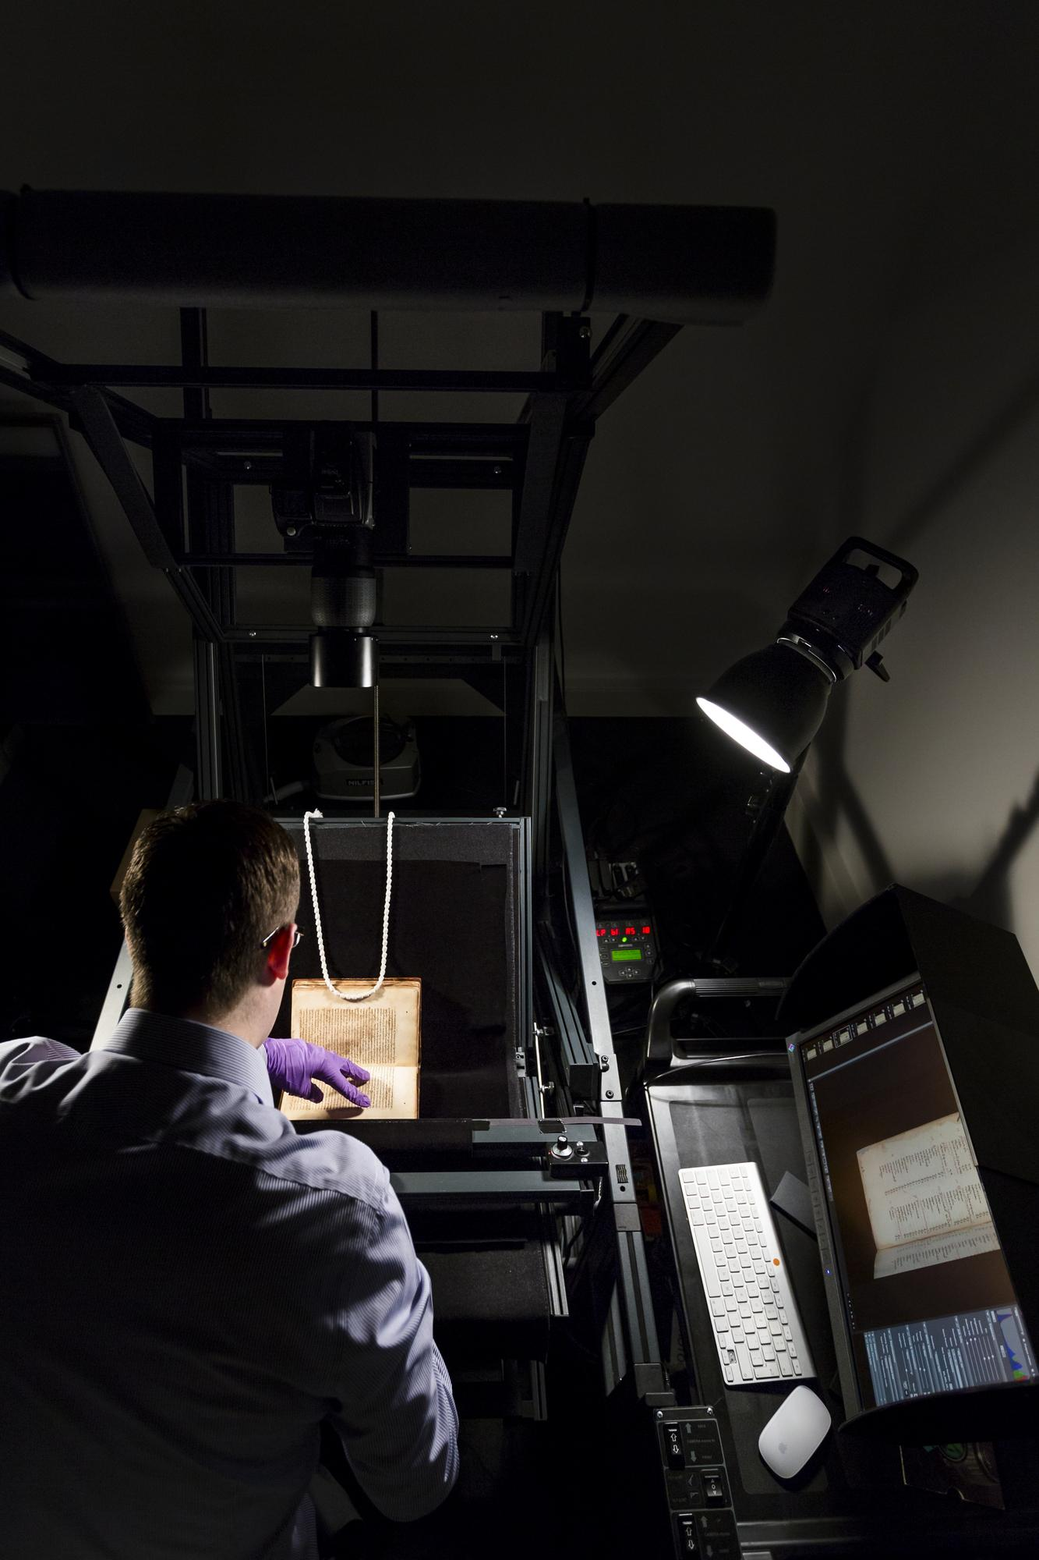
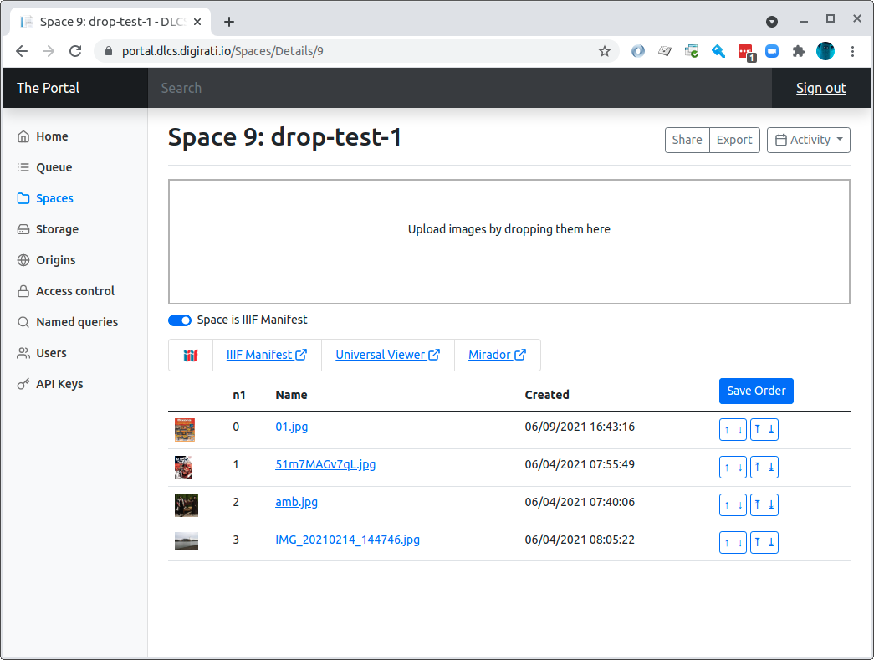
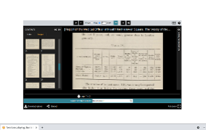
Isn’t that an easier way to make a manifest?
Notes:
Isn’t that an easier way to make a manifest?
So why don’t Wellcome just create manifests directly, bypassing all that intermediate stuff?

Slide 12
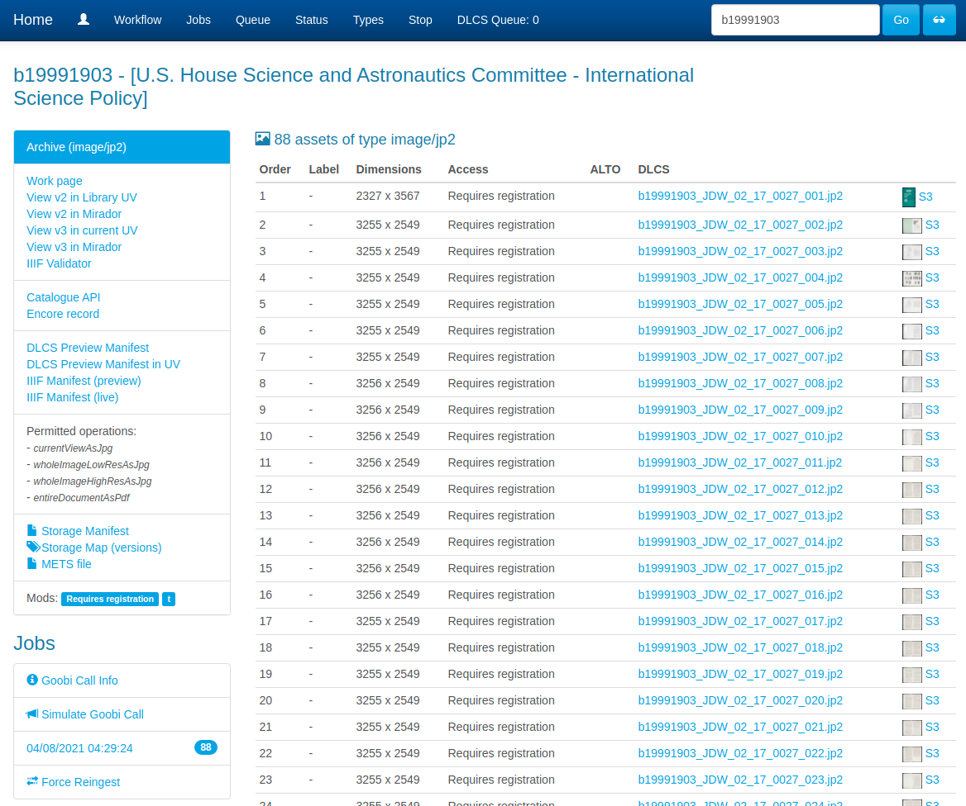
Observability and instrumentation
Notes:
Observability and instrumentation
Because there’s loads more going on and it would take hundreds of years like that.
There is text to process - 12 billion words of it and counting.
There is access control, there is structure - volumes, title pages, sections
In the time I was fiddling about with the Dixon’s catalogue, 10 books might have run through this process, overnight.
And all of it is observable, through dashboards.

Slide 13
Why do all this?
Mainly for the publisher to use the material themselves
Probably in one “canonical” way
But then later, in more specific additional ways
Then for other people to use it, with or without the knowledge of the publisher
By making derived presentations - mashups, visualisations, creative reuse, reinterpretation
Or for taking it into other IIIF-compatible software
for crowdsourcing
for research purposes
And perhaps, contributing to aggregators like Europeana or DPLA; other environments for Discovery and exploration
And perhaps, a National Collection
Notes:
Why do we do all this, anyway? All this IIIF stuff? And what’s this got to do with a National Collection?
Mainly so the publisher can use the material themselves
Probably in one “canonical” way
But then later, in more specific additional ways - it becomes content to re-use.
Then for other people to use it, in those same additional ways - with or without the knowledge of the publisher
By making derived presentations - mashups, visualisations, creative reuse, reinterpretation
Or for taking it into other IIIF-compatible software
for crowdsourcing
for research
And perhaps, contributing to aggregators like Europeana or DPLA; other environments for Discovery and exploration
And perhaps, a National Collection
The end result of this is a whole set of linked text and annotation resources, and APIs on top of them, incorporating machine-readable information from multiple sources such as Wellcome’s Catalogue API, and digitisation information from METS files. This allows external consumption of Wellcome IIIF. Here’s one example of aggregation - OpenTexts, by the National Library of Scotland -

Slide 14
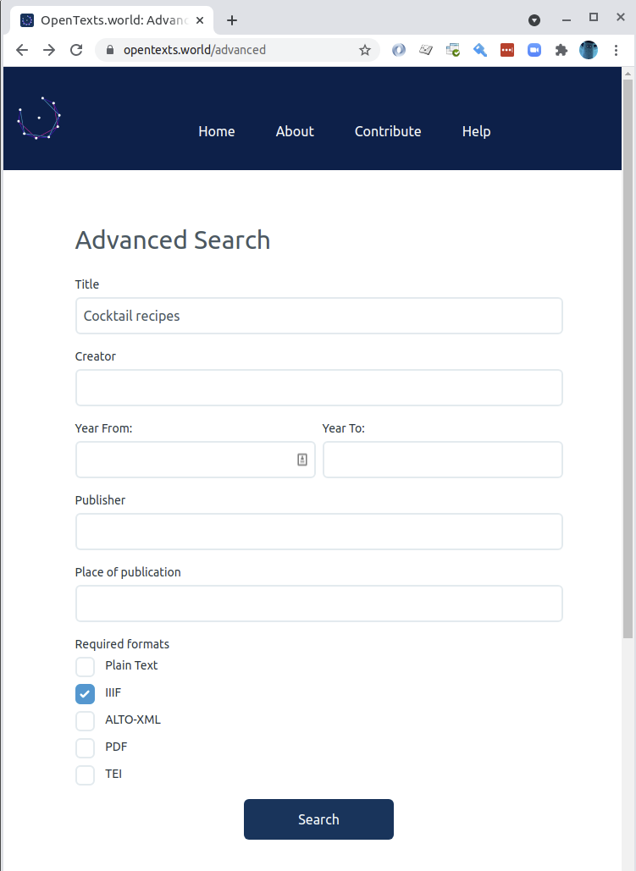
Notes:
OpenTexts harvests things that have text associated with them. Many Wellcome manifests fall into this category.
If I want to find cocktail recipes, I’m not limited to only searching Wellcome’s things:

Slide 15
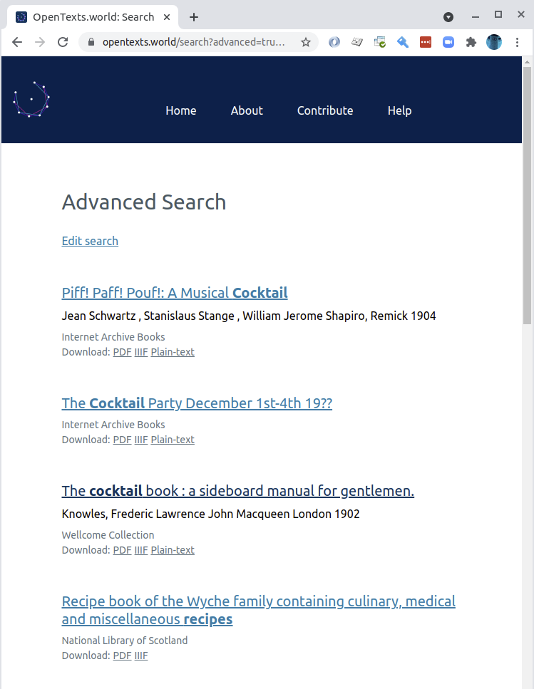
Notes:
There are results from many places here

Slide 16
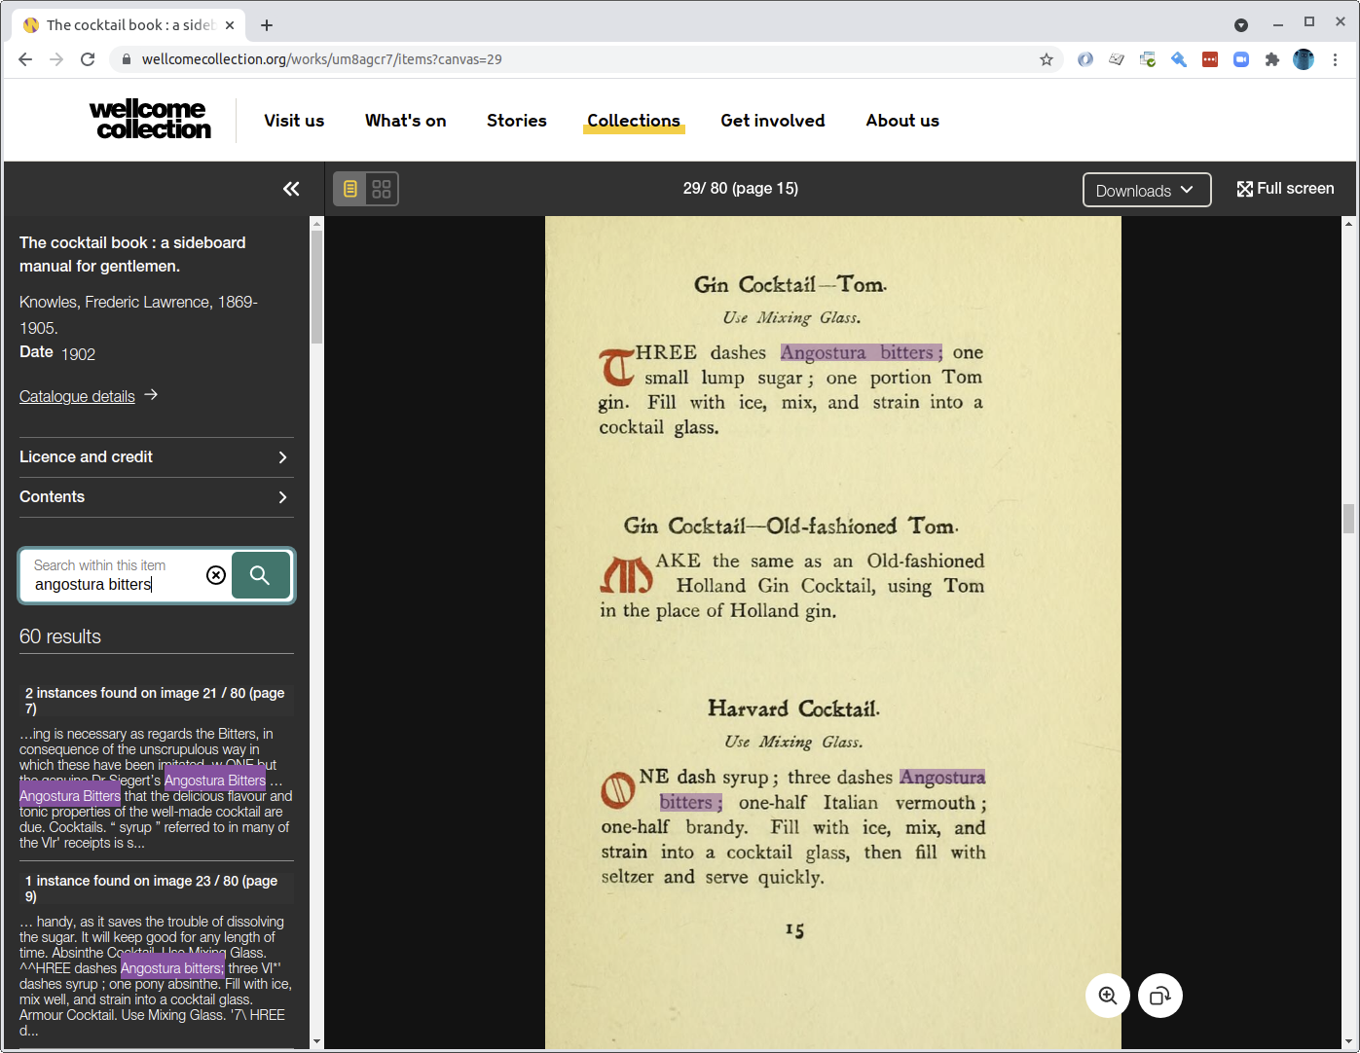
Notes:
The Wellcome one takes me to wellcome collection - where I can do further text searching using the IIIF Search API provided by the Digital Delivery Service we saw earlier.
OpenTexts is really meant to get you access to the text and optionally the publisher’s context for the text (like this page), rather than provide a rich exploration and engagement interface of its own.

Slide 17
What does this all mean for a digital National Collection?
Assumption: IIIF is the means by which National Collection objects are distributed to user interfaces
Which means contributors have to provide it
Some of this activity HAS to be specific to the publisher - it’s their stuff, they have to arrange and describe it, link it to sensible descriptive metadata
Some of it can use common tools, services, platforms, libraries
Notes:
What does this all mean for a digital National Collection?
Assumption: IIIF is the means by which National Collection objects are distributed to user interfaces
Which means contributors have to provide it
Some of this activity HAS to be specific to the publisher - it’s their stuff, they have to arrange and describe it, link it to sensible descriptive metadata
Some of it can use common tools, services, platforms, libraries

Slide 18
Big IIIF costs money
Institutions that have large digital workflows already can add bespoke and appropriate IIIF creation to those workflows.
Organisations and individuals with a handful of objects can create manifests by hand, host them on GitHub.
What’s the answer for orgs with a few hundred or a few tens of thousands of things?
Notes:
Big IIIF costs money Institutions that have large digital workflows already can add IIIF creation to those workflows.
People with a handful of objects can create manifests by hand, host them on GitHub.
What’s the answer for orgs with 50,000 things?

Slide 19
IIIF is only an answer to part of it
Deep-zoom is nice, but...
Notes:
IIIF is only an answer to part of it
There is a lot more to this than IIIF; on its own it only provides one part of what TANC needs. For the bit it can do, I think it’s the right choice - but there’s much more.
Deep-zoom is nice, but

Slide 20
IIIF is only an answer to part of it
Deep-zoom is nice, but
Having Manifests is more important that having deep-zoom, but...
Notes:
Having IIIF Manifests is more important that having IIIF deep-zoom
Wikipedia commons, Flickr and others are fine with a selection of different sized full images, rather than deep zoom. It’s the IIIF Manifest, that carries these images, that’s the key to interoperability and all those reuse scenarios, not the deep zooming.

Slide 21
IIIF is only an answer to part of it
Deep-zoom is nice, but
Having Manifests is more important that having deep-zoom, but
Having Manifests is no good if a National Collection has no means of discovering them, and...
Notes:
Even if everyone is publishing manifests, that’s no good if a National Collection has no means of discovering them
Every museum, library and gallery in the country could have rich IIIF representations of all their things, but how would they get into a National Collection and how would it stay up-to-date? Hint… look at the IIIF Change Discovery API.

Slide 22
IIIF is only an answer to part of it
Deep-zoom is nice, but
Having Manifests is more important that having deep-zoom, but
Having Manifests is no good if a National Collection has no means of discovering them, and
A National Collection can’t do much with those Manifests without a scheme to organise them by, and...
Notes:
Even if A National Collection can learn about all the things and stay in sync with all those contributors, it can’t do much with those Manifests without a scheme to organise them by.
IIIF Manifests have no descriptive semantics, but they can point at one or more pieces of descriptive metadata. Harvest a manifest, and you can follow the links to descriptive metadata. A National Collection will need to pick a lightweight metadata scheme (or small family of schemes) that is easy for contributors to produce, to map their own schemes onto. The difficulty of agreeing what this is - social, political at least as much as technical - should not be underestimated.
I’m not talking about a heavyweight complex taxonomy here. I think that a National Collection should be open to knowledge reorganisation by its users and derived systems - but it still needs something to underpin it, and people don’t yet publish the cultural heritage equivalent of schema.org.

Slide 23
IIIF is only an answer to part of it
Deep-zoom is nice, but
Having Manifests is more important that having deep-zoom, but
Having Manifests is no good if a National Collection has no means of discovering them, and
A National Collection can’t do much with those Manifests without a scheme to organise them by, and
It’s no good to humans without a lot of user research and design, some of which informs what that scheme, or schemes, might be
Notes:
But even then… it’s no good to humans without a lot of design work, some of which informs what that descriptive scheme, or schemes, might be
...Design informed by a good understanding of research and education (and entertainment) needs, but also a vision of the potential of such a significant piece of the public intellectual commons. User Research should help to steer this ship.

Slide 24
Thank you!
These slides: bit.ly/tanc-tc2
Tom Crane
Technology Director, Digirati cultural-heritage.digirati.com
@tomofhernehill
A bit more reading on the IIIF Universe Beyond the Viewer: fragments and links in annotation space

